Slide 1

University management system (UMS)
First Semester C Project on :
Team members :
Hemlata joshi :BCT8014
Jelina bhatt :BCT8016
Jyoti chand :BCT8017
4. Mohit bhatt :BCT8024
5. Pooja bhatt :BCT8031 6. Prashant saud :BCT8033 [computer engineering, 4th batch]
School of engineering FAR WESTERN UNIVERSITY Mahendranagar, kanchanpur

Slide 2
TABLE OF CONTENTS
13)second level diagram
Abstract
8) feasibility analysis
2) Introduction
9) risk analysis
3) objective
10)case diagram
4)problem analysis
11) flowchart
5) methodology
12)first level diagram
6) key features
7) application
14)conclusions

Slide 3
01
Abstract
This C program implements a comprehensive University Management System for managing books, students, and librarians.
The system includes separate functionalities for administrators and librarians.
Administrators can add, update, and list librarians, as well as manage current and passout students.
Librarians can manage library operations such as adding, listing, issuing, and removing books, as well as handle student information.
The program ensures user authentication, enforces unique book IDs,role selection and maintains data consistency through file operations.

Slide 4
Introduction
02
UMS is designed to enhance the efficiency and organization of university operations to optimize academic administration.
UMS aims to provide a comprehensive solution for managing both library resources and student records.
Library management module facilitates seamless tracking of books, borrowing activities, and inventory updates.
Student Management module manages student records, enrollment processes, and academic performance.

Slide 5
03
Problem analysis
UMS has become a necessity for modern educational institutions due to the increasing complexity of managing various academic and administrative activities.
UMS provide a centralized database for storing and managing various data related to students, faculty, courses, and other academic activities.
It is a powerful tool that can help educational institutions to manage various educational and administrative activities.
The adoption of ums can lead to improved student outcomes ,cost savings, and operational efficiencies.

Slide 6
It aims to automate library management tasks such as book tracking, borrowing, and inventory control.
Objectives
04
UMS is to develop an integrated platform for efficient academic administration.
It seeks to streamline student management by automating record keeping, processes, and academic performance monitoring.
project intends to reduce manual errors and save administrative time.

Slide 7
Methodology
05
Identify the requirements: The first step is to identify the requirements of the UMS by understanding the different modules and functionalities required, such as student management, library management, and administrative functions.
Analyze the requirements: Once the requirements have been identified, they need to be analyzed to understand their scope, feasibility, and priority by identifying data, technology, or time.

Slide 8
05
Methodology
Design the system: Based on the requirements analysis, the system architecture and design can be developed by defining the data structures, algorithms,flowchart, and user interface design.
Develop the system: With the system design in place, the development program can begin by coding the software and integrating different modules.
Test the system: Once the system is developed, it needs to be tested to ensure that it meets the requirements and is free of bugs and errors.

Slide 9
Deploy the system: After testing, the system can be deployed to the live environment. This includes installing and configuring the software on the server and providing user access.
05
Methodology
Maintain the system: After deployment, the system needs to be maintained to ensure that it continues to function correctly. This includes like bug fixes, software upgrades, and security updates.
Evaluate and improve: Finally, the University Management System should be evaluated regularly to identify areas for improvement.

Slide 10
Key features
06
Role selection: It allows user to select roles i.e. admin and librarian . Admin has control over whole system but librarian has control over library management and students.
Library management: The system should be able to manage the university library, including book records and updation.
Student Management:The system should be able to manage all aspect of student data, enrolments, personal information,academic records, attendance,and exam results.

Slide 11
Application
07
UMS is a practical application designed for academic institutions to enhance operational efficiency.
facilitates library management by automating book tracking, loans, and inventory control.
student management through automated handling of records, enrollments, and academic performance tracking.
UMS help to reduce manual errors and saves time for administrative staff and as well as it helps to keep records safely.

Slide 12
Feasibility analysis
08
It is economically and technically feasible.
It is machine independent, efficient and reliable.
It is highly secured , flexible and can be modified whenever software requires any update.
It meet the all specifications as required by the user and it is reusable

Slide 13
Risk analysis
09
Unauthorized access : Third party could attempt to gain access to the UMS to steal or modify student records, financial data,or other sensitive information.
Data loss : data loss could occur due to system failure,data corruption , or other technical issues, leading to the loss of critical student records or library records.

Slide 14
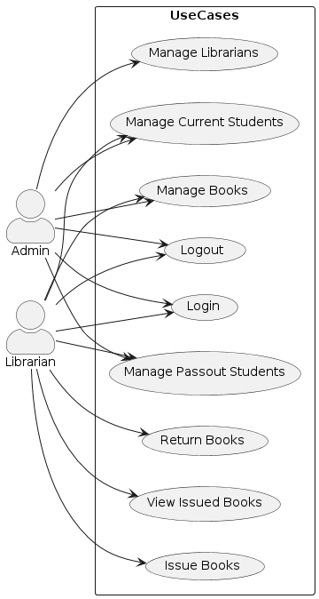
10
Component diagram

Slide 15
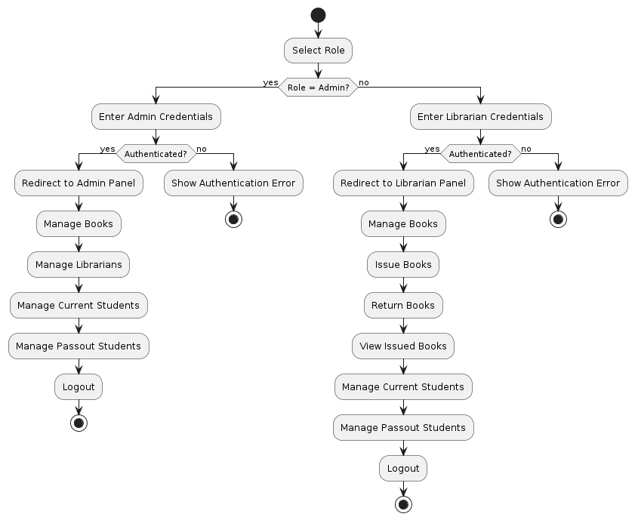
flowchart
11

Slide 16
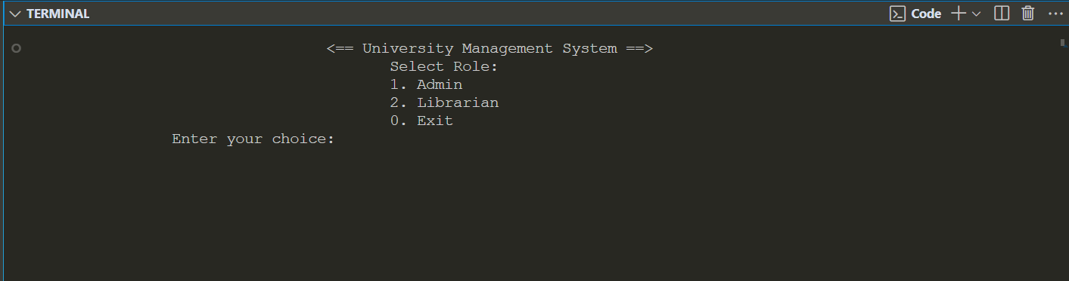
First level diagram

Slide 17
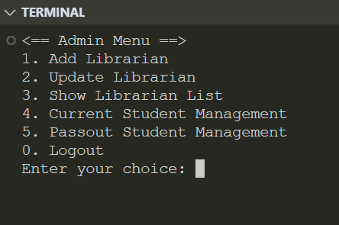
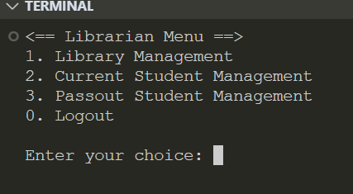
Second level diagram
13

Slide 18
Conclusion
14
University Management System (UMS) is an essential tool for academic institutions to manage their administrative tasks effectively.
It allows for streamlined processes, improved data management, and increased efficiency in handling student records, faculty data, course scheduling, financial management, and more.
Furthermore, a UMS can be tailored to meet the specific needs of different institutions, ensuring that it aligns with their unique requirements.

Slide 19
It can also be integrated with other systems and applications to improve functionality and usability.
16
Conclusion
Overall, a University Management System is a crucial investment for academic institutions seeking to improve their operations and provide better services to their stakeholders.

Slide 20
Thank you !
Do you have any questions?
jelinabhatt1@gmail.com
+9779822745107

